Slide 1
Representation of a circle in a Hexagonal Grid using Python
By Prit Raj and Kousik Biswas
Under the guidance of Dr. Arindam Biswas

Slide 2
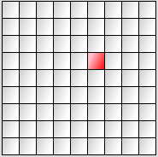
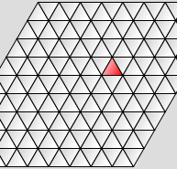
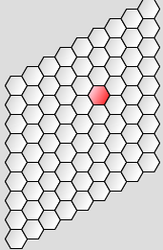
Types of Grids
Square Grid
Triangular Grid
Hexagonal Grid

Slide 3
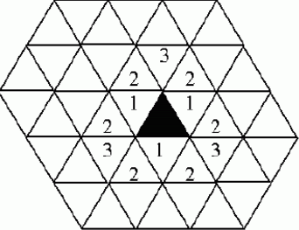
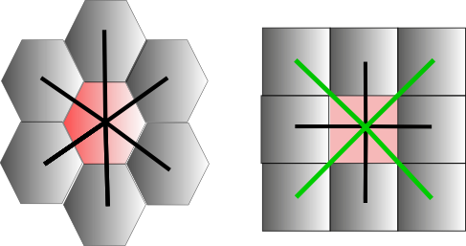
Concept of Neghbourhood
Triangular Grid
Hexagonal Grid
Square Grid

Slide 4
Hexagonal Grids
Why?
Advantages
Disadvantages
Offset Coordinates
Cube Coordinates
Axial Coordinates

Slide 5
Why use the hexagonal Coordinate System?
People are very used to operate with traditional square lattice.
Lack of input and output devices that map onto hexagonal lattice.
Hexagonal lattices are much denser than the square lattice of the equivalent size, unless the images are fed in at a larger resolution than it is operated on images have to extrapolate some pixel location .

Slide 6
Practicalities of using a Hexagonal Coordinate system
There are 4 major considerations in this case which are Image Conversion, Addressing and Storage, Image Processing Operation, Image Display .
IMAGE CONVERSION: Hardwares capable of capturing images directly into a hexagonal lattice is highly specialized thus not generally available for use, so square latticed images needs to be converted into Hexagonal lattice
ADDRESSING AND STORAGE: An indexing system that is easy to follow and a storage that is capable of storing hexagonal lattice images are desired.
IMAGE PROCESSING OPERATION: Operations must be designed and or be converted that are geared to exploit the strength of the system
IMAGE DISPLAY: Display devices generally do not use hexagonal lattices so images need to be converted

Slide 7
Issues with Hexagonal Coordinate System
People are very used to operate with traditional square lattice.
Lack of input and output devices that map onto hexagonal lattice.
Hexagonal lattices are much denser than the square lattice of the equivalent size, unless the images are fed in at a larger resolution than it is operated on images have to extrapolate some pixel location .

Slide 8
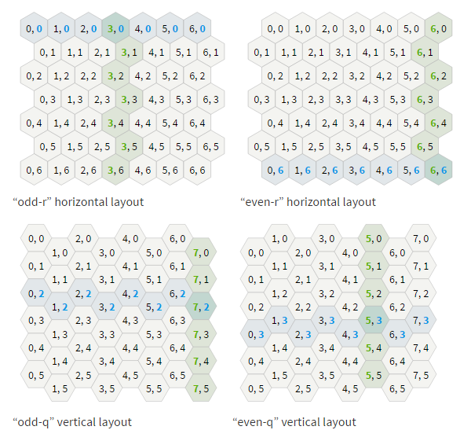
Offset Coordinates
Every other row or column is offset.
Row offset results in “odd-r” and “even-r” horizontal layout.
Column offset results in “odd-q” and “even-q” vertical layout.
It is a simple approach but it is difficult but implementation of geometrical properties becomes difficult.

Slide 9
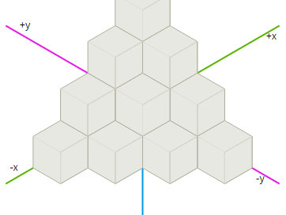
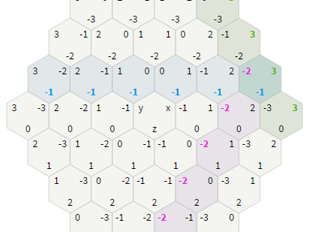
Cube
Coordinates
It invloves visualizing 3 axes at equal angular distances, i.e 120 degrees.
Take a cube grid and slice out a diagonal plane at x + y + z = 0. The resultant figure is shown aside.
This figure shows cubes in an orientation such that its outlines denote a hexagon.
We can reuse standard operations from cartesian coordinates: adding coordinates, subtracting coordinates, multiplying or dividing by a scalar, and distances.

Slide 10
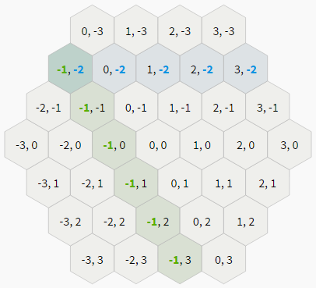
Axial
Coordinates
The axial coordinate system is built by taking two of the three coordinates from a cube coordinate system.
Since we have a constraint such as x + y + z = 0, the third coordinate is redundant.
Axial coordinates are useful for map storage and for displaying coordinates to the user.

Slide 11
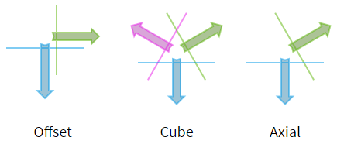
Axis
The axis is the direction in which that coordinate increases.
Perpendicular to the axis is a line where that coordinate stays constant. The grid diagrams show the perpendicular line.
We will be using the Axial Coordinates for this project.

Slide 12
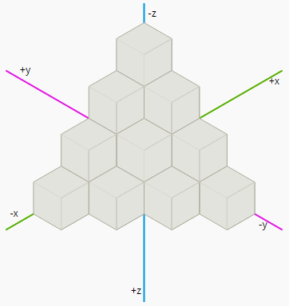
Distance
In the cube coordinate system, each hexagon is a cube in 3d space.
Adjacent hexagons are distance 1 apart in the hex grid but distance 2 apart in the cube grid. In a cube grid, Manhattan distances are abs(dx) + abs(dy) + abs(dz). The distance on a hex grid is half that.
cube_distance(a, b)
=(abs(a.x - b.x) + abs(a.y - b.y) + abs(a.z - b.z)) / 2
axial_distance(a, b)
=(abs(a.q - b.q) + abs(a.q+b.r -b.q- b.r) + abs(a.r - b.r)) / 2

Slide 13
Hexagonal Grid Maths

Slide 14
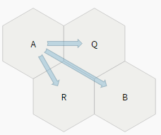
Hex to Pixel
For axial coordinates, the way to think about hex to pixel conversion is to look at the basis vectors. In the diagram, the arrow A→Q is the q basis vector and A→R is the r basis vector. The pixel coordinate is q_basis * q + r_basis * r. For example, B at (1, 1) is the sum of the q and r basis vectors.
function hex_to_pixel(hex):
x = SIZE * math.sqrt(3) * (hex.q + hex.r/2)
y = SIZE * 3/2 * hex.r
return Point(x, y)

Slide 15
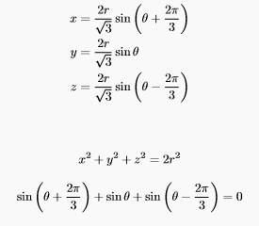

Identities

Slide 16
Circle
A circle has a constant distance from a fixed point. So we have the following:-
Parametric form of Circle is given by:-
x =[2r/√3*(sin(t + 2π/3))]+p
y=[2r/√3*sin(t)]+p

Slide 17
Implementation
Naive
Bressenham

Slide 18

Naive Implementation
Input: r - radius, (cx, cy) - center
Output:coordinates of circumference circle
Steps of the algorithm:
1: Declare x, y
2: for t=0 to 360 do
3: x=[(2r/√3)*sin(t+2*π/3)]+cx
4: y=[(2r/√3)*sin(t)]+cy
5: draw_hex(x, y)
6: end for

Slide 19
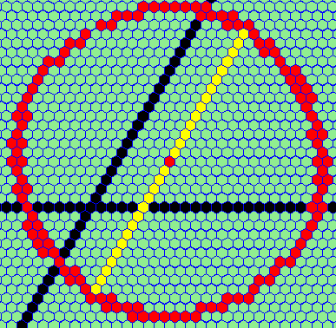
Naive Implementation - Result
Center = (5, 5); Radius=15
As we can see the naive approach doesn’t work.
There are disconnected hexagonal cells at some points in the circle.
At some other places more than 2 adjacent hexagonal cells are present for a particular cell.
This happens because we are approximating a circle without any constraints.

Slide 20
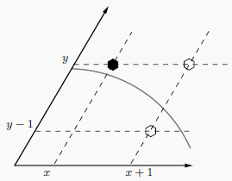
Bressenham Algorithm
Input: r - radius, (cx, cy) - center
Output: x, y - coordinates of circle
Steps of the algorithm:
1: x=0, y=r, p=1/4
2: while y>=x do
3: draw_hex(x, y)
4: if p<0 then
5: p=p+2*x+y+5/2
6: else
7: p=p+x-y+11/4
8: y=y-1
9: end if
10: x=x+1
11: end while

Slide 21
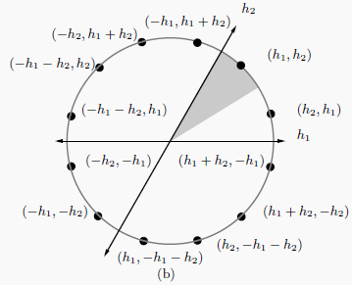
Bressenham Algorithm - Symmetry
A circle in hexagonal grid has 12 symmetric points as shown in the figure.
So, we only need to draw points for 30 degree circumference of the circle, the shaded portion in the figure. The rest can be drawn symmetrically.
We start at x=0, y=r and draw until x>=y.

Slide 22
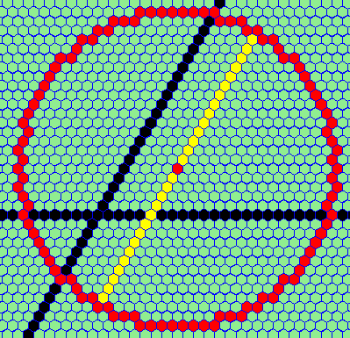
Bressenham Algorithm - Result
Center = (5, 5); Radius=15
As we can see it is a significant imrovement over the naive approach.
There are no disconnected hexagonal cells because (x, y) -> (x+1, y-1) or (x+1, y) both are adjacent.
We only do integer operations, so it is faster.

Slide 23
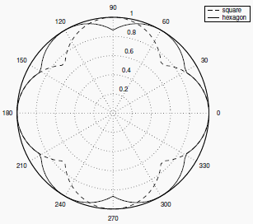
Conclusion
From this project we conclude that a circle or any curve can be better represented in a Hexagonal grid.
Also the accurateness of approximation of a circle increases as we increase the number of sides in the polygon but there will be disconnectedness.

Slide 24
References
[1] Lee Middleton, Jayanthi Sivaswamy, and Professor Sameer Singh, Advances in Pattern Recognition Springer, 2005.
[2] Herman Tulleken, Hex Grid Geometry for Game Developers, 2015
[3] Innchyn Her, Geometric Transformations on Hexagonal Grids, IEEE Transactions on Image Processing , VOL. 4, NO. 9, September 1995
[3] URL: “http://www.redblobgames.com/grids/hexagons” , Hexagonal Grids
[4] URL: “http://www-cs-students.stanford.edu/~amitp/gameprog.html#hex” Amit’s game

Slide 25


